Slide 1
Explainability for Crypto Trading
Interpretable AI for Financial Models

Slide 2
TL;DR
• Crypto markets are volatile and unpredictable.
• Explainability reveals WHY a model buys or sells.
• Improves trust, safety, and transparency.

Slide 3
Motivation
• Black-box models make risky financial decisions.
• Explainability validates and debugs model behavior.
• Important for investors and regulators.

Slide 4
Problem Definition
• Goal: Understand logic behind Buy/Sell/Hold signals.
• Challenge: crypto data changes rapidly.
• Need stable, interpretable explanations.

Slide 5
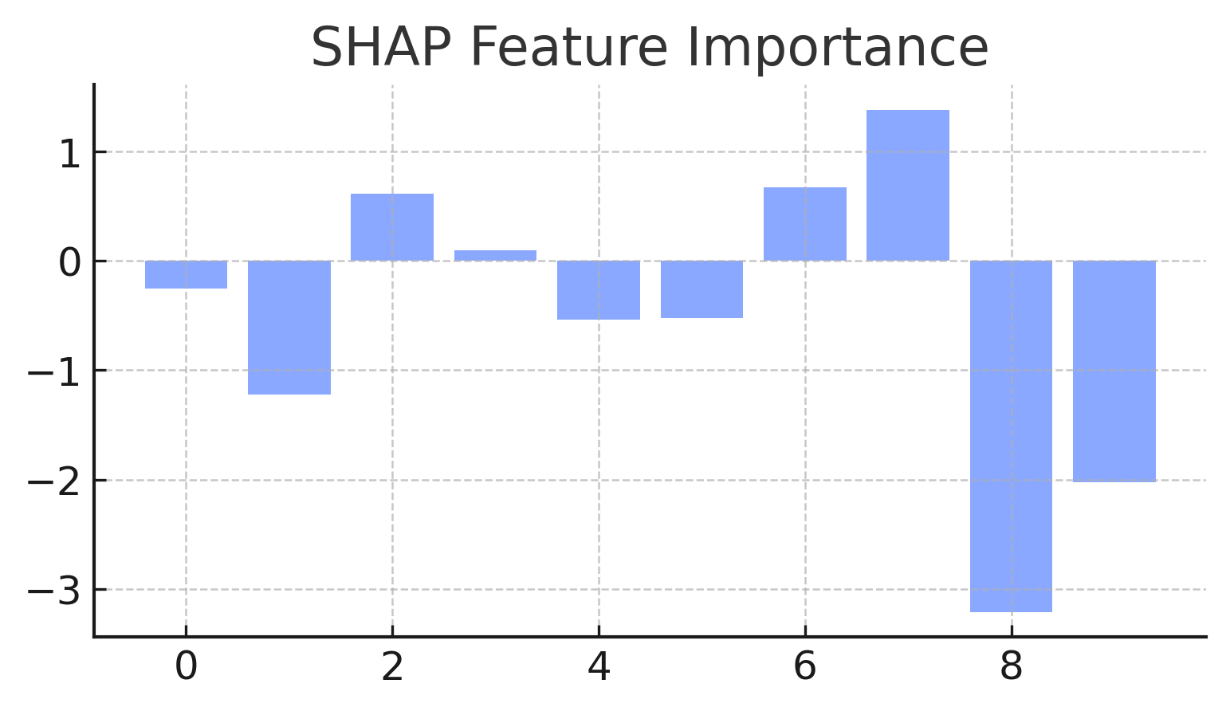
SHAP Feature Importance
What this shows:
- Global importance of each feature.
- Positive values push toward Buy; negative toward Sell.
Why it matters:
- Shows which signals the model relies on.
- Detects overreliance or missing indicators.

Slide 6
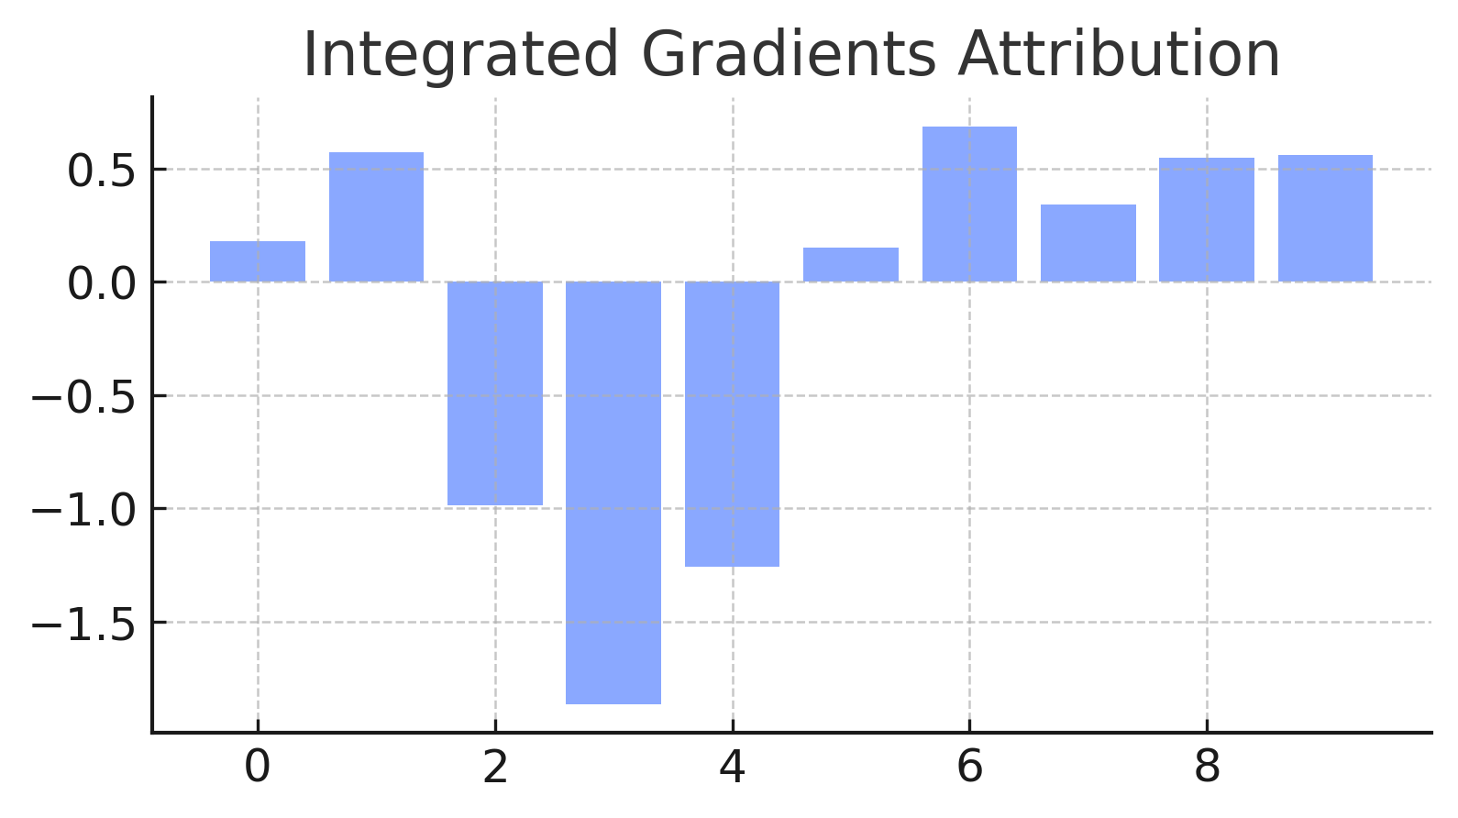
Integrated Gradients Attribution
What this shows:
- Sensitivity of output to changes in input.
- Explains logic behind each individual prediction.
Why it matters:
- Shows which signals triggered a Buy/Sell.
- Helps validate and troubleshoot trades.

Slide 7
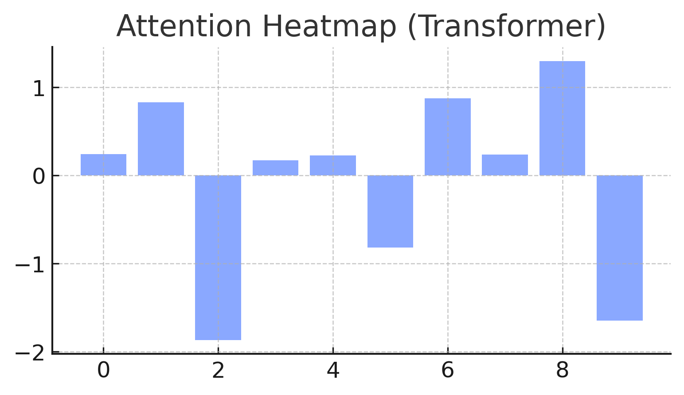
Attention Heatmap (Transformer)
What this shows:
- Highlights time steps the model focuses on.
- Bright areas = stronger importance.
Why it matters:
- Checks if model reacts logically to volatility.
- Ensures temporal reasoning matches trading logic.

Slide 8
Results Summary
• Buy: momentum indicators (RSI, MACD, EMA).
• Sell: volatility spikes + reversal patterns.
• Matches typical financial trading intuition.

Slide 9
Ethical Considerations
• Explanations can mislead if misunderstood.
• Volatility reduces explanation reliability.
• Avoid overtrusting automated trading systems.

Slide 10
Conclusion & Future Work
• Explainability improves transparency + trust.
• Future: sentiment signals, counterfactuals, user studies.
• Need better evaluation metrics for financial AI.

